Slide 1
Modelling power in handcycle: an overview
Modelling the RPE
Modelling the Power output

Slide 2
Analysis of the model: what did we focus on?
Principal component analysis: What are the most relevant features?
Analysis of PCA
What’s the impact of IMU Data on the model? Do they improve the performance?
Comparison of model created with and without IMU Data
Can RPE be modeled and if yes, does it improve the Power output model?
Considerations over our results

Slide 3
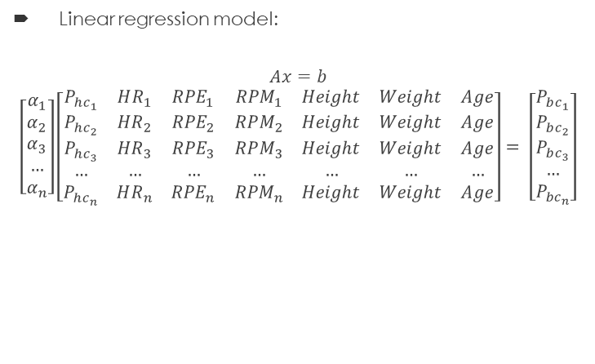

What models were used?
Linear model: α as a corrective factor
$$P_{bc}=α ∗P_{hc}$$
With
$$α=\frac{α_{1}+ α_{2}+ α_{3}}{3}$$
$$α=\frac{P_{bc, RPE}}{P_{hc, RPE}}$$
Linear regression model:
$$Ax=b$$
$$\left[\begin{aligned}α_{1} \\ α_{2} \\ α_{3} \\ … \\ α_{n}\end{aligned}\right]\left[\begin{matrix}P_{hc_{1}} & HR_{1} & RPE_{1} & RPM_{1} & Height & Weight & Age \\ P_{hc_{2}} & HR_{2} & RPE_{2} & RPM_{2} & Height & Weight & Age \\ P_{hc_{3}} & HR_{3} & RPE_{3} & RPM_{3} & Height & Weight & Age \\ … & … & … & … & … & … & … \\ P_{hc_{n}} & HR_{n} & RPE_{n} & RPM_{n} & Height & Weight & Age\end{matrix}\right]= \left[\begin{aligned}P_{bc_{1}} \\ P_{bc_{2}} \\ P_{bc_{3}} \\ … \\ P_{bc_{n}}\end{aligned}\right]$$
Support vector regression:
-> Approximates the continuous-valued function minimizing the prediction error.

Slide 4
How were the models trained?
RPE model:
- Feature extraction over windows of 180 s and 60 s length
Linear regression (LinearRegression package from sklearn)
Support vector regression (SVR pavckage from sklearn)
Power output model
Alpha as ratio between P_bc and P_hc
Linear regression
SVR?
How were the models tested?
Leave p-out method: 1 subject left out of the training set and used as test set. The model gets iteratively trained with a new test set
- Variables considered: r^2 value

Slide 5
RPE Model: Feature extraction
From Zwift data (Power, Heart Rate, Cadence)
Mean
Min and Max
Standard and Median abs deviation
Energy and entropy
Interquartile range
Kurtosis
Skewness
Percentage of max value
Total of 37 features
For IMU Data, in addiction:
Psd mean, min and max
Feature extraction was performed on the acceleration along the X, Y and Z axis and on the rotation along the same axes
Total of 205 features

Slide 6
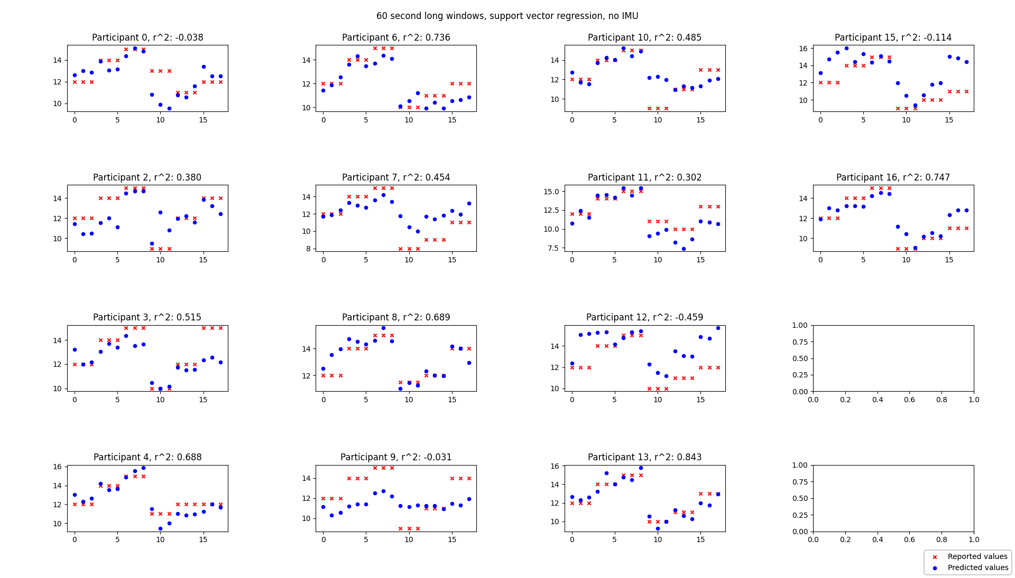
Model performance: 60 second windows
r^2 minimum:
- 0.114
r^2 maximum:
0.736
r^2 average:

Slide 7
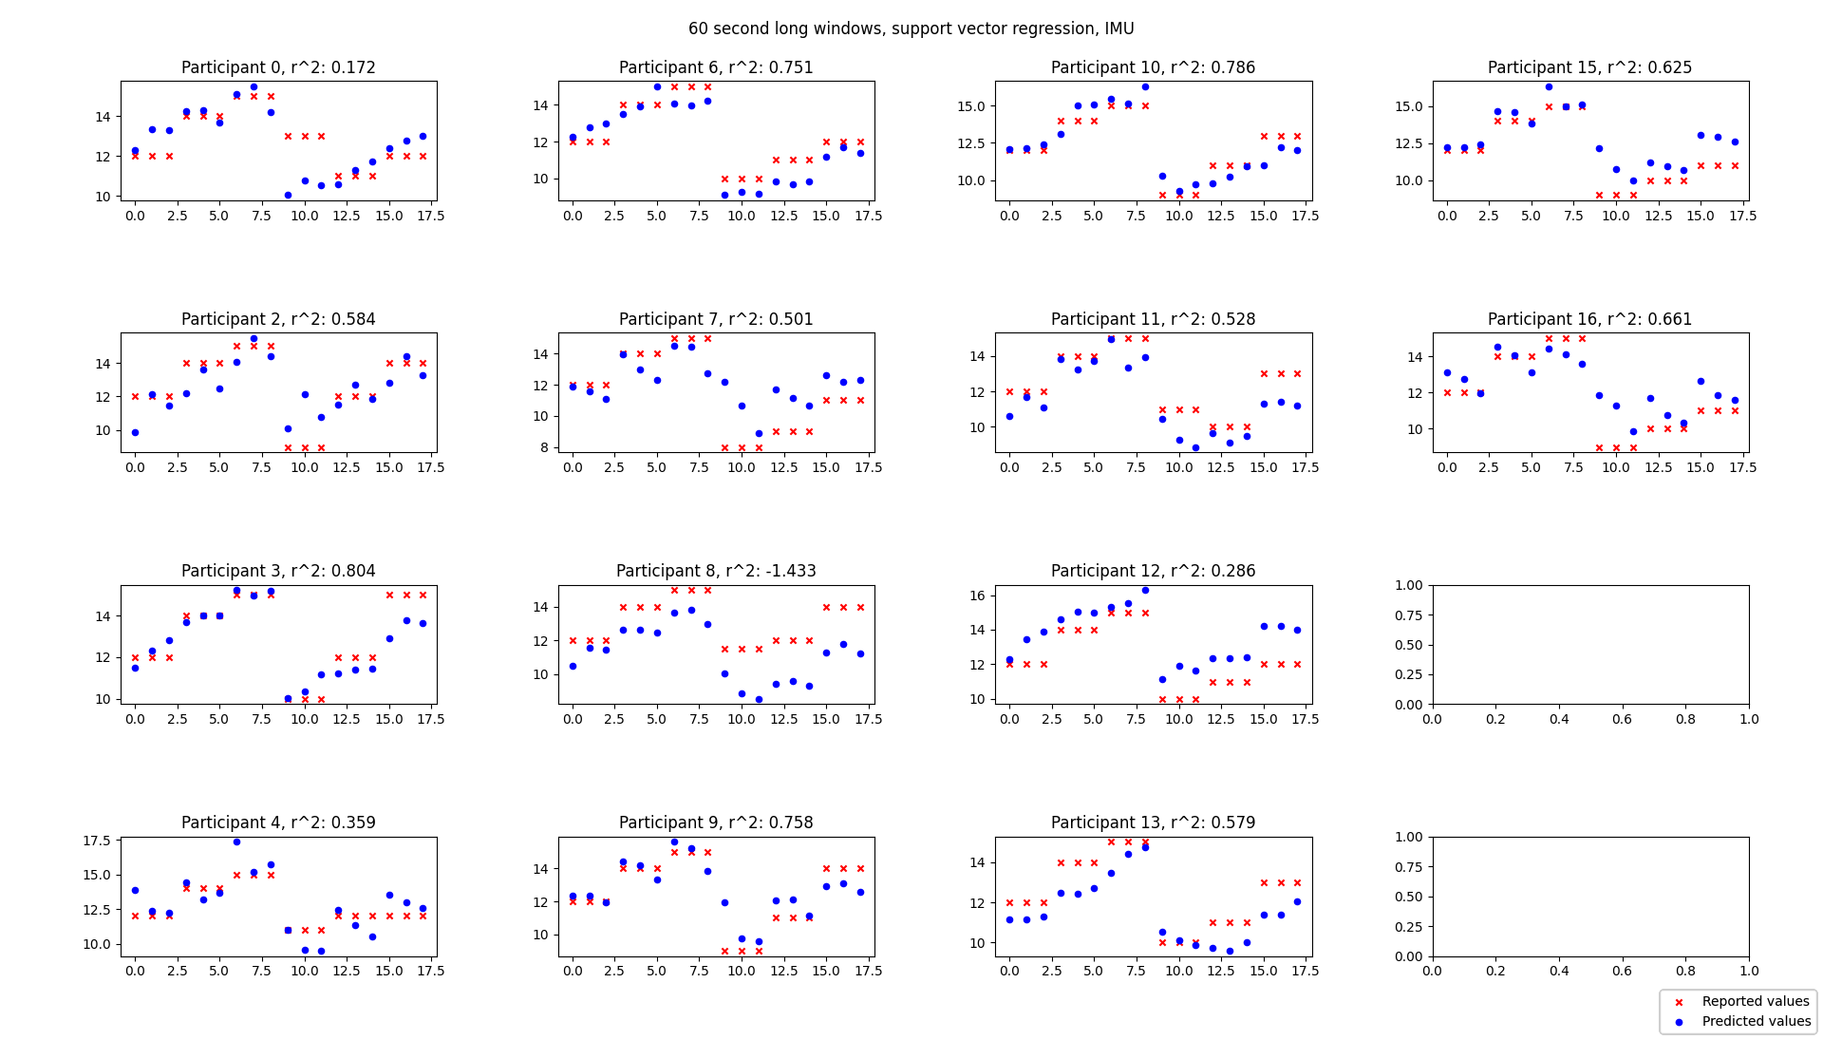
Model performance: 60 second windows

Slide 8
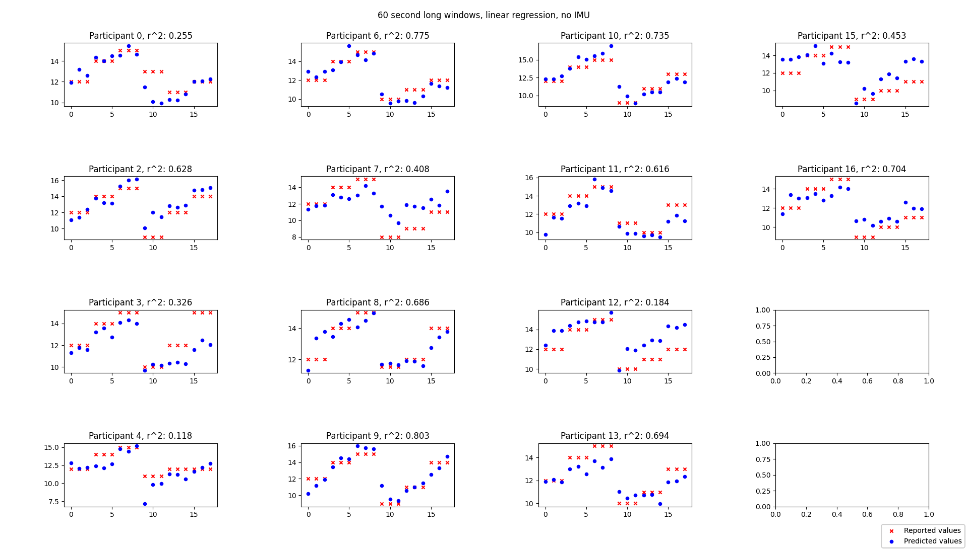
Model performance: 60 second windows

Slide 9
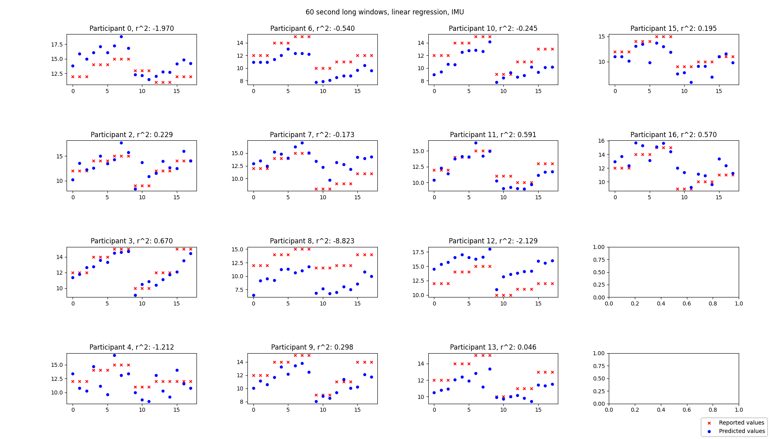
Model performance: 60 second windows

Slide 10
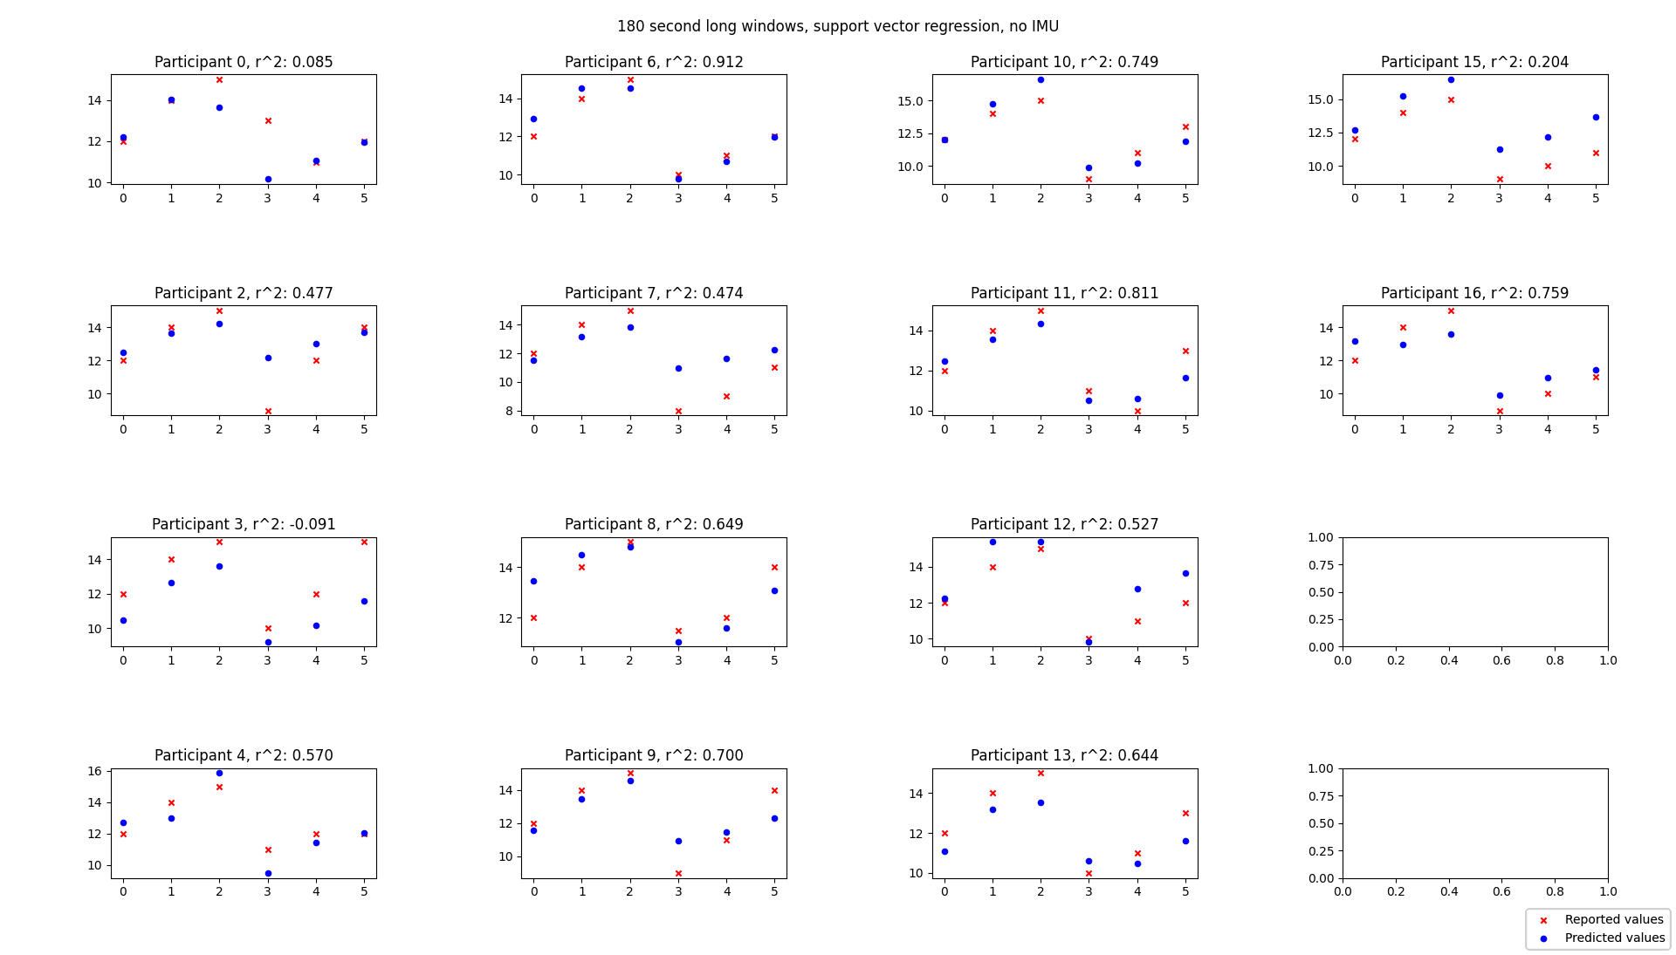
Model performance: 180 second windows

Slide 11
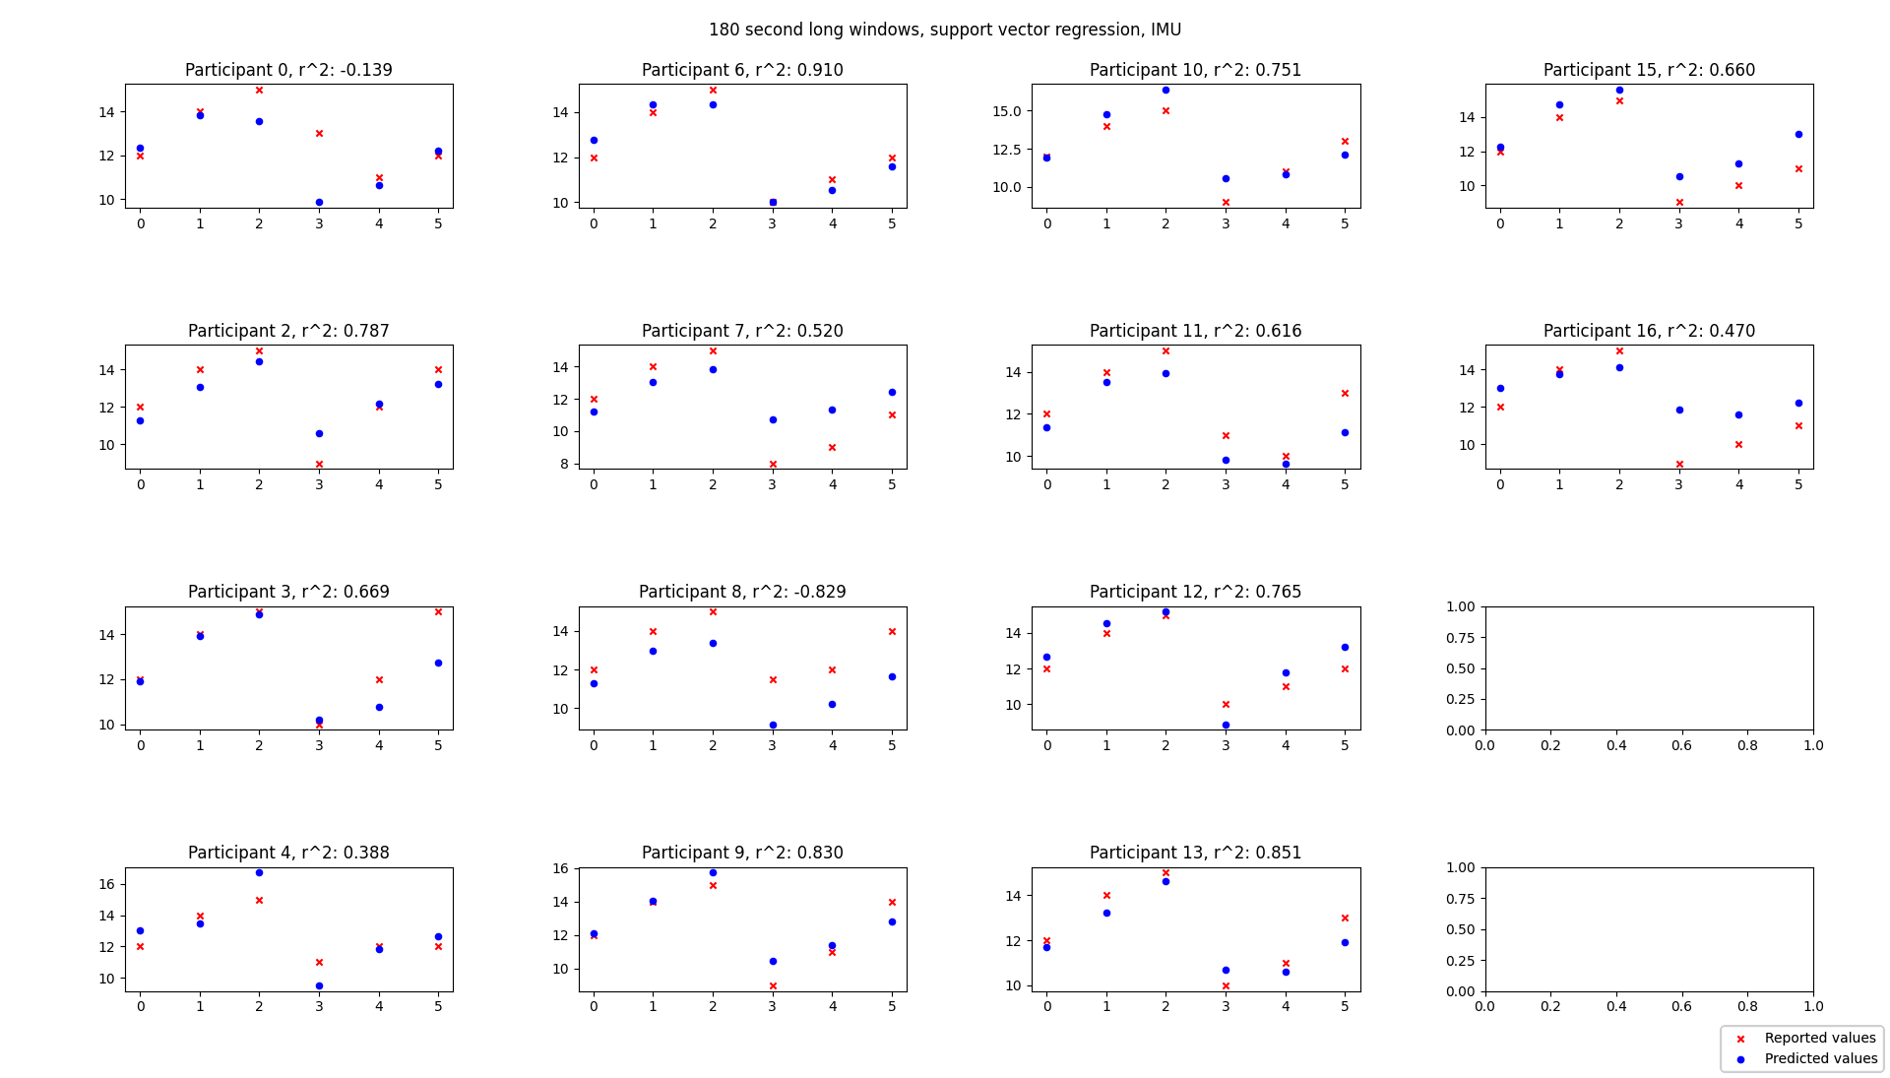
Model performance: 180 second windows

Slide 12
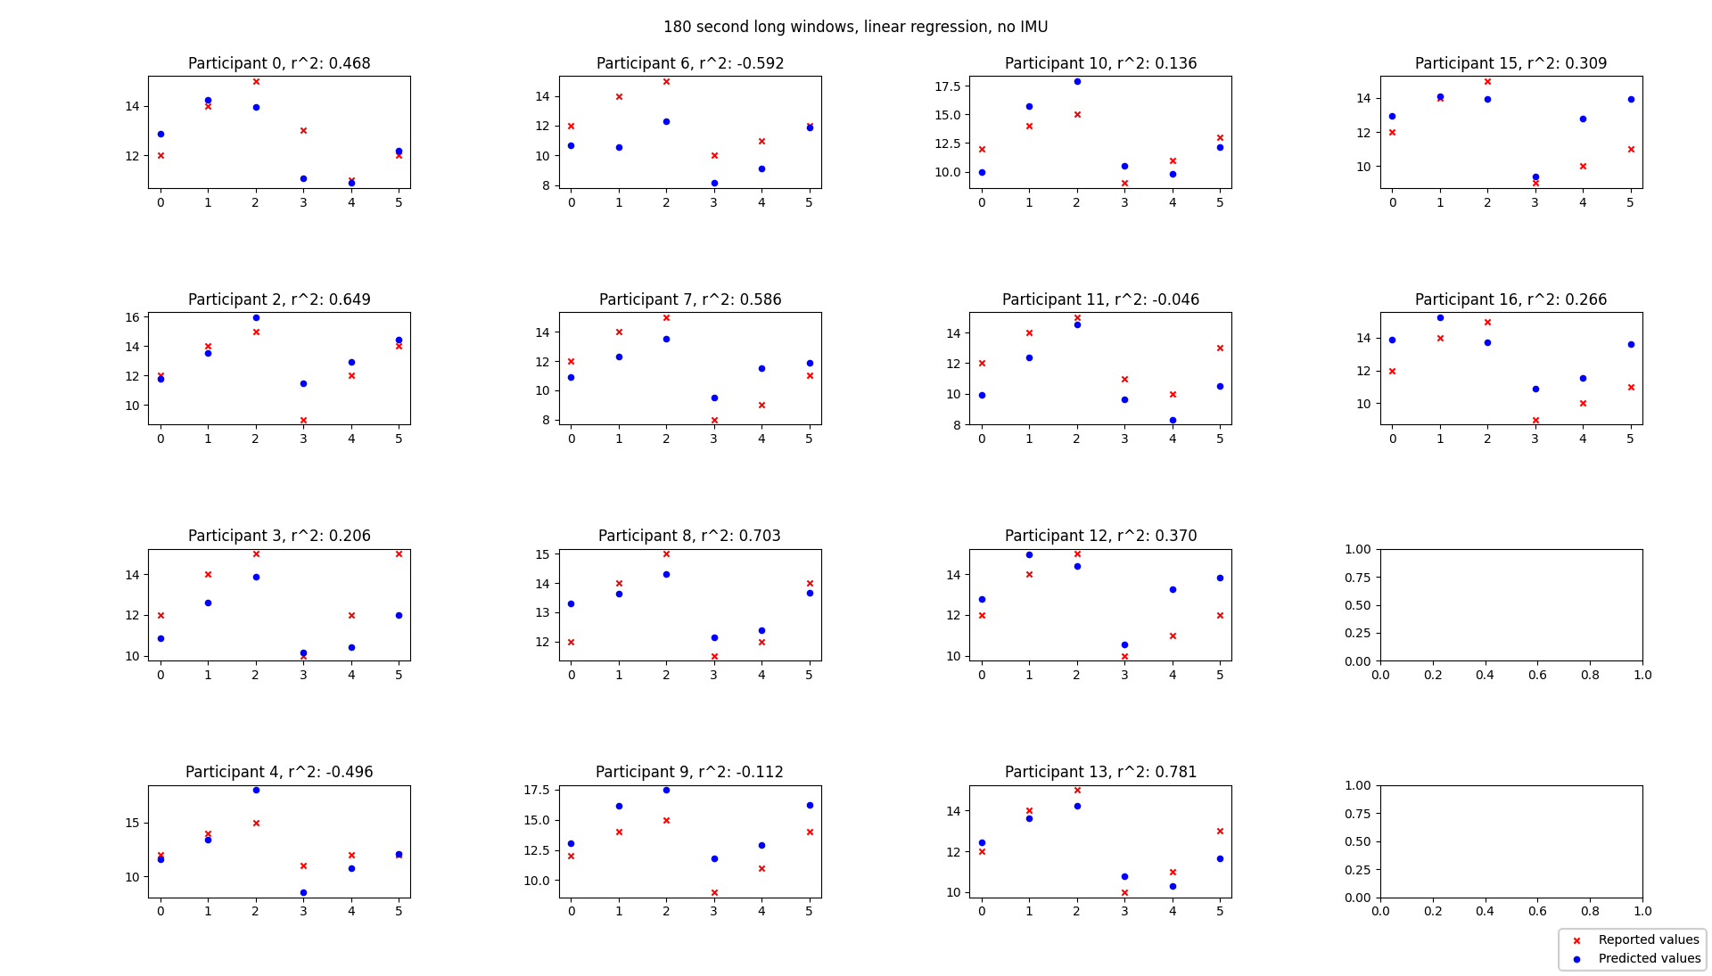
Model performance: 180 second windows

Slide 13
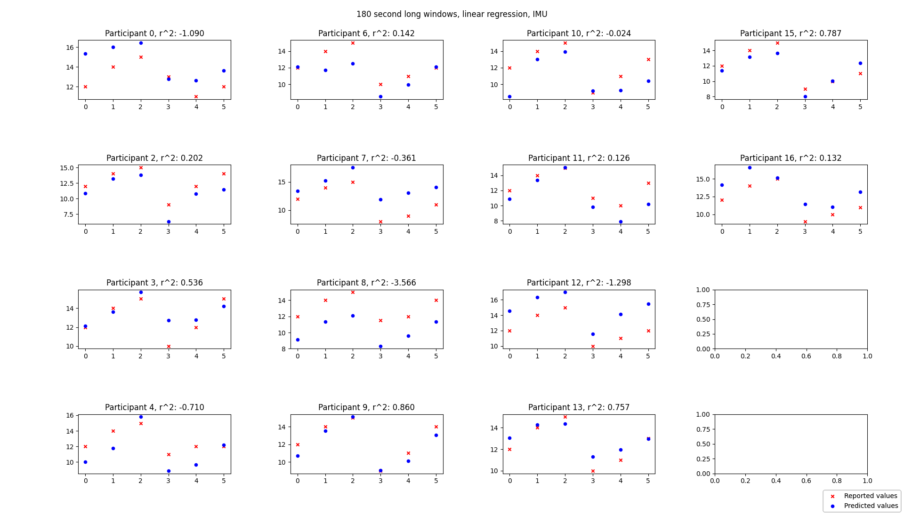
Model performance: 180 second windows

Slide 14
Conclusions:
Best regression methos = SVR
Best window length = 180 seconds
IMU Data do not seem to affect the final results too much, so we can skip it for the sake of testing the model in real time.

